Slide 1
Search Problems
HW1 is due tonight
Optional HW2 Recitation on Wednesday 8-9pm
Read the AIMA textbook Chapter 3 “Problem Solving by Search” (Sections 3.1-3.4). Quiz on Canvas due by Sunday.
Professor Chris Callison-Burch
Notes:
https://www.polleverywhere.com/activities
videos:
-
authors: SRI International
url: https://www.youtube.com/watch?v=7bsEN8mwUB8
title: Shakey the Robot&colon; The First Robot to Embody Artificial Intelligence
length: 6 minutes
This module will introduce a broad class of problems in artificial intelligence called search problems. We can formulate many problems in computer science as search problems, all of which can be solved using the same set of methods.
The problem-solving methods that we’ll look at in this module come from earlier work in algorithms, especially shortest path algorithms. We'll see how we can apply shortest path algorithms to many problems where we need to search through a space of possible sequences of actions in order to reach our desired goal.
In this module, you will learn how to formally define a search problem, and about a range of different algorithms for arriving at a solution for this general mathematical definition of search problems. The class of search algorithms that we’ll be look at in this module is called uninformed search algorithms. The “uninformed” part of the name comes from the fact that we don't have any additional information about the environment that we're exploring. In the next module, we’ll look at how we can use additional information to enhance the search algorithms.
We will look at classic algorithms like depth first search and breadth first search then we'll also look at some interesting variations on them that have some nice computational complexity features.

Slide 2
Example Search Problems
AIMA 3.1-3.3
Notes:
In module 1, we defined a rational agent as an agent that could select the best action to maximize its performance measure, given an input percept sequence.
Sometimes it isn’t immediately obvious what the best action is to take. In that case, an agent needs to plan ahead and consider many possible sequences of actions. This process of planning ahead from and trying to formulate the best possible sequence of actions is called search. Agents that perform search are called problem-solving agents.

Slide 3
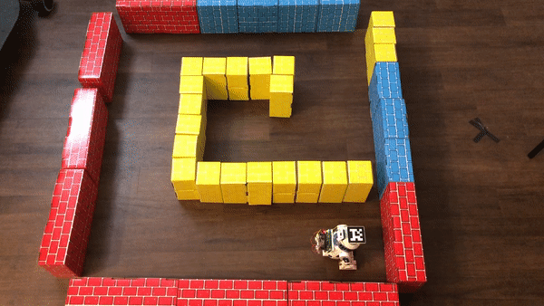
Reflex Agents
A simple reflex agent is one that selects an action based only on the current percept.
It ignores the rest of the percept history.
Notes:
The simplest type of agent is a simple reflex agent. A simple reflex agent uses the incoming sensor data, which we defined as a percept, and uses the current percept in order to decide what action to take.
The example that we have here is a simple reflex agent that uses the sensor data from an ultrasonic range finder. It uses a very simple algorithm to decide what to do:
It drives ahead until its sensors tell it that it’s about to hit a wall,
If it detects a wall ahead of it, it stops,and then it turns to the left to see if there's a wall there too.
If so, then it turns 180 degrees.
Once there isn't a wall ahead of it, it drives forward.
The main difference between this simple reflex agent, and a more complicated agent is that this agent simply reacts to its immediate surroundings and does not plan ahead.

Slide 4
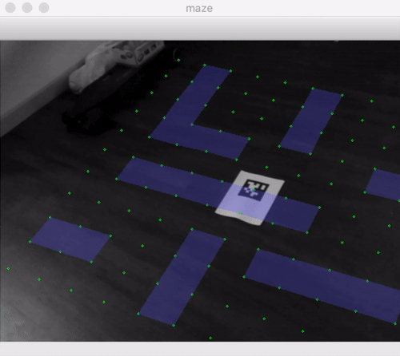
Problem-Solving Agent
A problem-solving agent must plan ahead.
The computational process that it undertakes is called search.
It will consider a sequence of actions that form a path to a goal state.
Such a sequence is called a solution.
Notes:
A problem solving agent cannot simply pick a single action based on the current percept. Instead, it has a goal in mind and has to plan a sequence of actions in order to reach that goal.
This process of planning a sequence of actions is called search in artificial intelligence. It’s different from what we have commonly come to know as internet search. Instead, the term search refers to the process of searching for a solution, which consists of a sequence of actions from the current state that our agent finds itself in into some desired goal state.
[AR Example]
In this video, I show a problem solving agent. I clicked on certain squares in the grid that I want the agent to visit, indicated by the red dots. The blue dot represents the agent’s starting point, each of the red dots is the point that we want the robot to visit.
The problem solving agent must find a sequence of actions that takes it from that start state to the goal states. The solution is a path. There can be multiple paths from the start state to the goal state. That means there are multiple solutions.
We are interested in the optimal solution. We are going to consider what it means for a solution to be optimal. We will have some criteria to allow us to compare solutions and tell us that this sequence of steps is better than other sequences that also arrive at the goal state.

Slide 5
Impact of Task Environments
The properties of the task environments change the types of solutions that we need.
If an environment is:
Fully observable
Deterministic
Known environment
The solution to any problem in such an environment is a fixed sequence of actions.
In environments that are
Partially observable or
Nondeterministic
The solution must recommend different future actions depending on the what percepts it receives. This could be in the form of a branching strategy.
Notes:
In module 1, we discussed task environments. The different qualities of the task environment impact the nature of the solutions to search problems.
[observable environment example]
Recall that we divided environments into fully observable environments versus partially observable ones. This reflects the difference between playing chess, where we see the complete state of the board at any given point in time vs. self-driving cars where we can't observe the entire environment and some elements of the environment are hidden
Chess is fully-observable and self-driving cars operate in partially observable task environments.
[deterministic example]
Similarly, we talked about other types of task environments where either the action that we selected would have a deterministic result. If we choose to move our Knight in chess, we know exactly where it will end up, because the results of making a move in chess is deterministic. In non-deterministic environments where an agent selects an action, the outcome may or may not be what it expects.
Later on in the course, we'll address stochastic environments, which are non-deterministic. In such environments, the outcome is uncertain, but we have an expectation of how likely each possible resulting state is, given that action that we've selected.
For this module, we will focus on fully observable, deterministic environments, where everything is known. If we have that kind of particular task environment, then the solution to any problem that we can formulate as a search problem is going to be a fixed sequence of actions.
This means that there can be an ordered list of actions that the agent can execute to move from its initial state to its goal state.
If we get into more complex environments where we either don't have all the information available when we're computing our solution, or when actions are non-deterministic then we need a different kind of solution. Instead a fixed sequence of actions, instead, we need to have a contingency plan. If I observed this outcome at this particular step in the sequence, then do this, otherwise do this.
We’ll begin by developing solutions for search problems in fully observable, deterministic environments where everything is known.

Slide 6
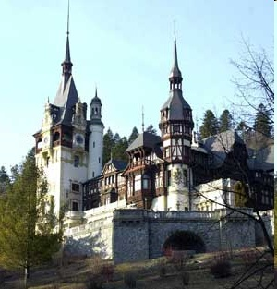

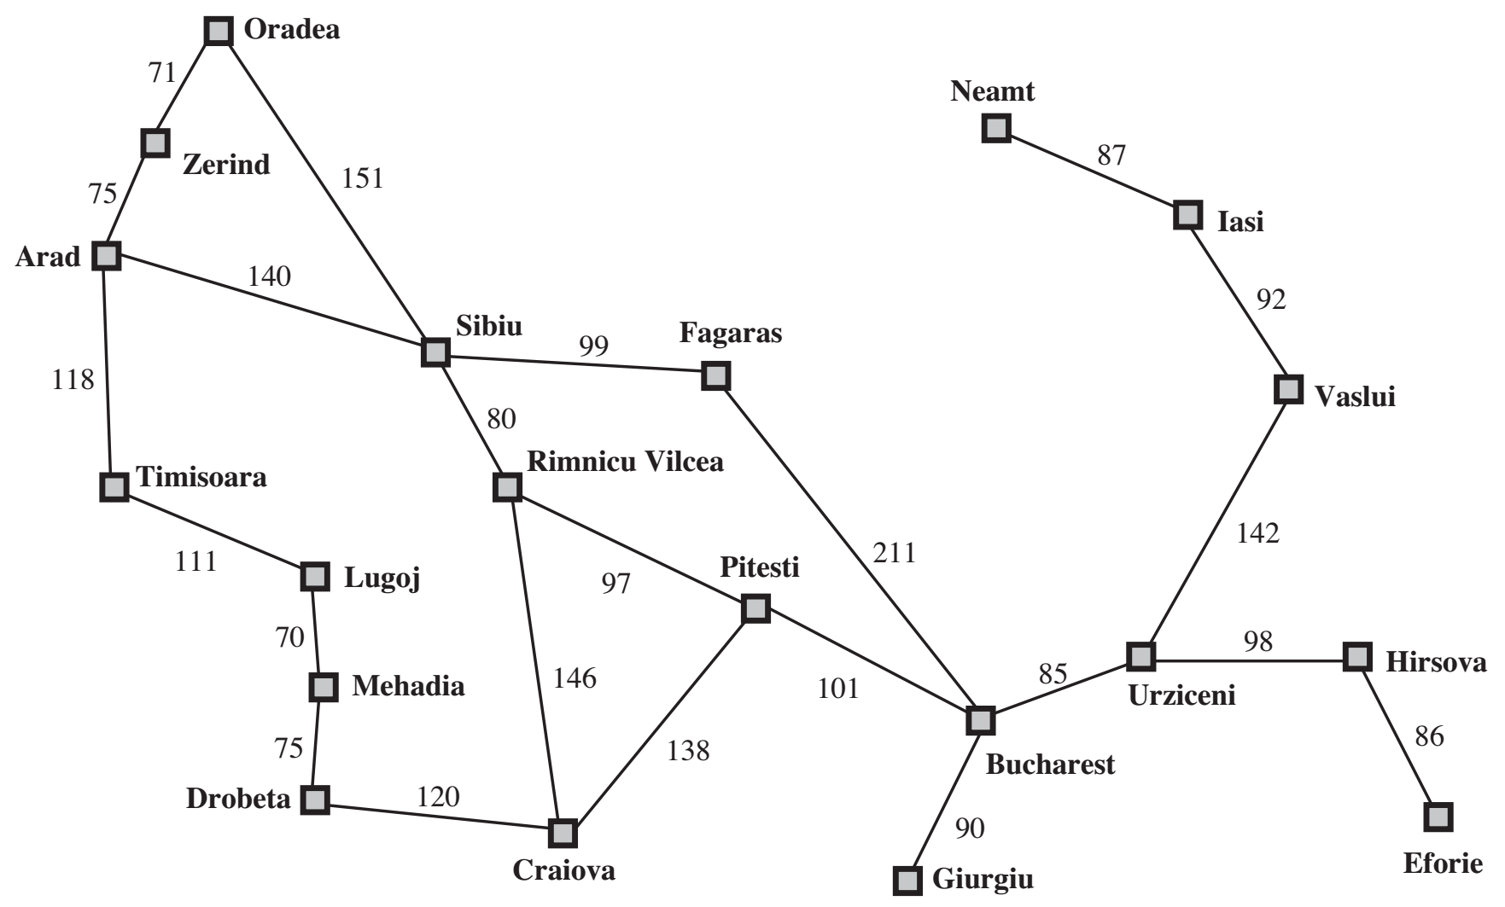
Example search problem: Holiday in Romania
You are here
You need to be here
Notes:
The textbook talks about taking a holiday in Romania. The narrative is pretty funny. They talk about finding yourself in the city of Arad then you suddenly realize you have a plane that leaves later that day from Bucharest. How do you get as quickly as possible from Arad to Bucharest?
I’ve got two hypotheses about why the textbook authors included this example. First, it might have been something that one of them actually experienced during an academic conference. It’s a very absent minded professor thing to do. Oh no, I’ve got to leave for the airport. How to I get to Bucahrest from here? My other hypothesis is that they picked Romania is the cities in Romania all start with unique alphabet letters on the alphabet from A, almost all the way to Z with no duplicates and very few left out. This allows you to conveniently write a graph with each of the nodes in the graph labeled as A to Z.
How do we formulate the task of trying to find your way from Arad to Bucharest as a search problem? We're going to have to formulate each of the same elements as we did for 8-puzzle: we need a goal, the set of possible states, the actions, and the performance measure.

Slide 7
Example search problem: Holiday in Romania
O
N
Z
I
A
S
F
You are here
R
T
V
L
U
H
P
M
B
D
C
G
E
You need to be here
J
K
Q
W
X
Y
Notes:
The textbook talks about taking a holiday in Romania. The narrative is pretty funny. They talk about finding yourself in the city of Arad then you suddenly realize you have a plane that leaves later that day from Bucharest. How do you get as quickly as possible from Arad to Bucharest?
I’ve got two hypotheses about why the textbook authors included this example. First, it might have been something that one of them actually experienced during an academic conference. It’s a very absent minded professor thing to do. Oh no, I’ve got to leave for the airport. How to I get to Bucahrest from here? My other hypothesis is that they picked Romania is the cities in Romania all start with unique alphabet letters on the alphabet from A, almost all the way to Z with no duplicates and very few left out. This allows you to conveniently write a graph with each of the nodes in the graph labeled as A to Z.
How do we formulate the task of trying to find your way from Arad to Bucharest as a search problem? We're going to have to formulate each of the same elements as we did for 8-puzzle: we need a goal, the set of possible states, the actions, and the performance measure.

Slide 8
Holiday in Romania
On holiday in Romania; currently in Arad
Flight leaves tomorrow from Bucharest
Formulate goal
Be in Bucharest
Formulate search problem
States: various cities
Actions: drive between cities
Performance measure: minimize travel time / distance
Find solution
Sequence of cities; e.g. Arad, Sibiu, Fagaras, Bucharest, …
Notes:
Let’s talk about how to represent the map navigation task as a search problem. In this case, the set of possible states is going to be the set of cities on the map. The current state will be whatever city we're currently in.
The goal state will be the city that we want to end up in. In this case, Bucharest.
The actions are going to be to drive from one city to another, provided that they're connected in this graph.
The solution is going to be a sequence of actions that we take in order to get from our initial state of Iran, to our final state, our goal, state of Bucharest. We can represent the solution as a list of cities that we travel through.
Then finally, we need to define a performance measure for the map navigation problem. We will want to minimize something, like the travel time or the distance.
Finding the solution to our holiday in Romania is a matter of applying an algorithm that will find the shortest path from Arad to Bucharest. This is similar to what happens when you get directions in Google maps. It's going to apply the same algorithms that we're learning about. The only thing that makes Google maps any more complicated than our problem is having to account for factors that can affect the duration of travel along a certain segment of road, which vary based on heavy traffic or accidents. The shortest paths search algorithms that we will develop are identical to what Google Maps uses.
The 8-puzzle and map navigation seem like totally different problems, but that can both be formulated as search problems. As a result, we we can apply exactly the same algorithms to solve them.

Slide 9
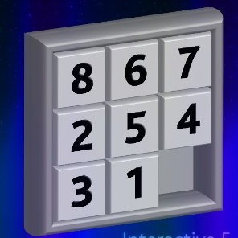

Example search problem: 8-puzzle
Formulate goal
Pieces to end up in order as shown…
Formulate search problem
States: configurations of the puzzle (9! configurations)
Actions: Move one of the movable pieces (≤4 possible)
Performance measure: minimize total moves
Find solution
Sequence of pieces moved: 3,1,6,3,1,…
Notes:
Puzzles are an interesting challenge problem for artificial intelligence, since they are fully observable and deterministic, and can be formulated as search problems.
It's useful to look at puzzles as a starting point, since they allow us to very clearly mathematically define the different elements that play a role in search problems.
[8-puzzle]
One running example that we’ll use is sliding tile puzzles. This instance of the sliding puzzle is called the eight puzzle. It consists of a 3 by 3 grid, with numbered tiles labeled 1 through 8, and a blank square in the ninth position on the grid.
In this puzzle, we will pick a series of moves to shift the tiles from their initial configuration onto the goal state, where tiles are arranged in increasing numeric order from one to eight.
[states]
One important part of formulating search problems is to define a set of possible states. The states for this puzzle game are the set possible configurations of puzzle pieces, meaning all possible orders of those 8 tiles plus the blank space.
[actions]
In all search problems, we're going to define a set of actions that are possible to move from one state to another state.
In this case, the actions are going to be sliding a tile, but it's equally good to think about it as moving the blank space.
When it’s in the center of the grid, the blank space can be moved to the left or to the right or up or down. When that blank space is on a side or in a corner, we have a smaller number of actions, but the maximum possible actions that we're going to have is 4: up, down, left, right.
[performance measure]
In module 1, we discussed how rational agents attempt to maximize a performance measure.
In search problems, we will use performance measures to determine whether a solution that takes us to the goal state is better than another solution that takes us to a goal state.
The performance measure will allow us to answer, how good are we at solving this puzzle? Clearly we'd like to solve it in the fewest possible moves because that's going to be the one where we beat our friends by solving the puzzle more quickly. Rather than maximizing the performance measure, we’re going to minimize the cost. In 8 puzzle, each action has a unit cost, meaning that moving left costs the same as moving right or up or down.
[solution]
Finally, a solution to a search problem is going to be a sequence of actions from the start state to the goal state. In this case, we can represent the sequence of actions by saying which tile moved at each step in time.
8-Puzzle is one example of a task that we can formulate as a search problem.
A seemingly unrelated task that can also be formulated as a search problem is the task of navigating a map.
-----
Sometimes a performance measure can be formulated in whether an agent satisfies a goal.
This Is called a sliding block puzzle. This instance is an 8-puzzle.
9! = 362880 possible configurations (half of them are legal 181k)
Family of sliding block puzzles are NP complete. 15 block puzzle (4x4 board has 16! = 20 trillion).
5x5 board has 10^25 states. That’s 15 septillion (15 million billion billion).

Slide 10
Why do we care about search? Doesn’t ChatGPT solve everything?
Opinions and commentary from your Professor

Slide 11

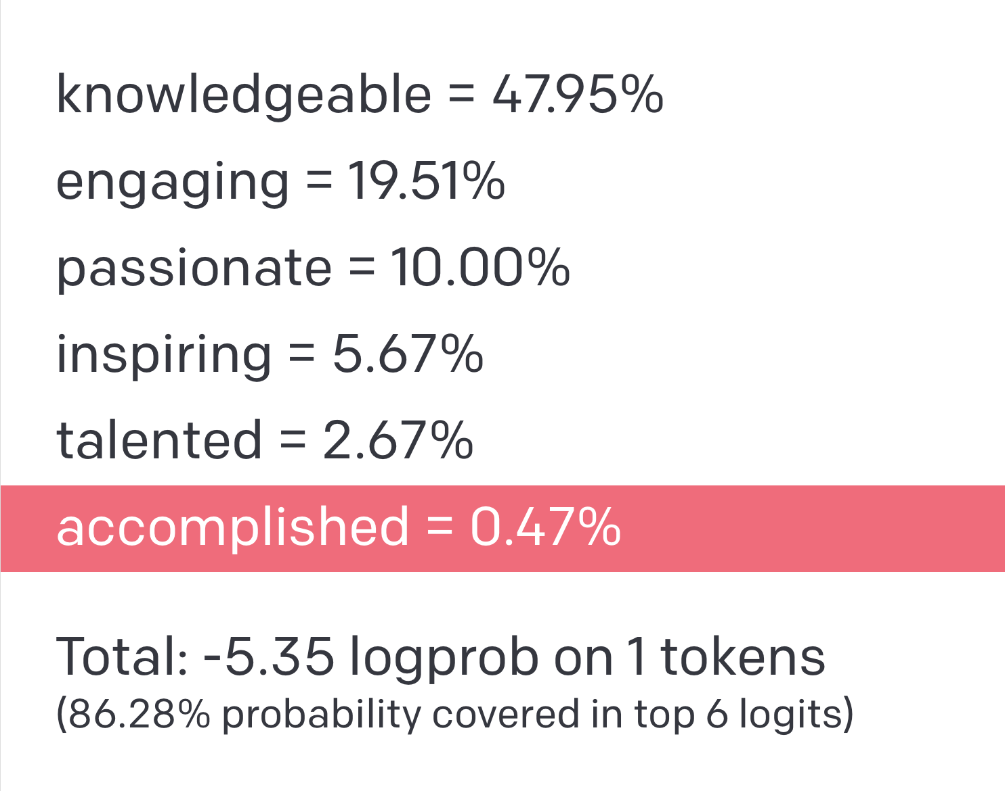
What are Large Language Models?
Prompt
Completion
Notes:
prompt / completion
few shot learning
fine-tuning

Slide 12

What are Large Language Models?
Few shot example
Prompts
Completions
“In-context Learning”
Notes:
Chris Callison-Burch | University of Pennsylvania | Computer and Information Science Department
Karen Rile | University of Pennsylvania | English Department
David Brainard | University of Pennsylvania | Psychology Department
Emily Falk | University of Pennsylvania | Annenberg School for Communication

Slide 13

What are Large Language Models?
Instruction following

Slide 14
Are LLMs Planning Agents? Let’s ask!
You are here
You need to be here
Notes:
https://www.polleverywhere.com/free_text_polls/1afdvEcNdmBOoC2pgl5Kk
Answer: Arad-Shibiu-Rimnicu_Vilcea-Pitesti-Bucharest
Cost: 418

Slide 15
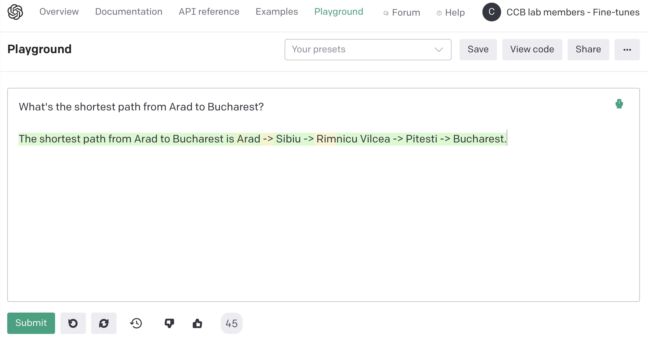
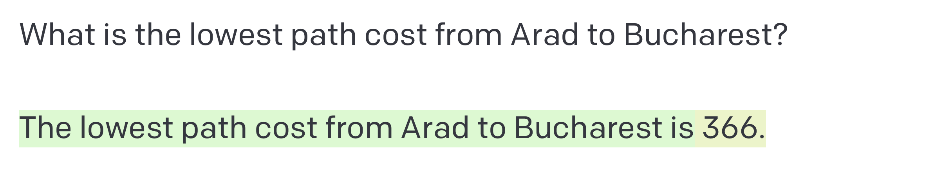
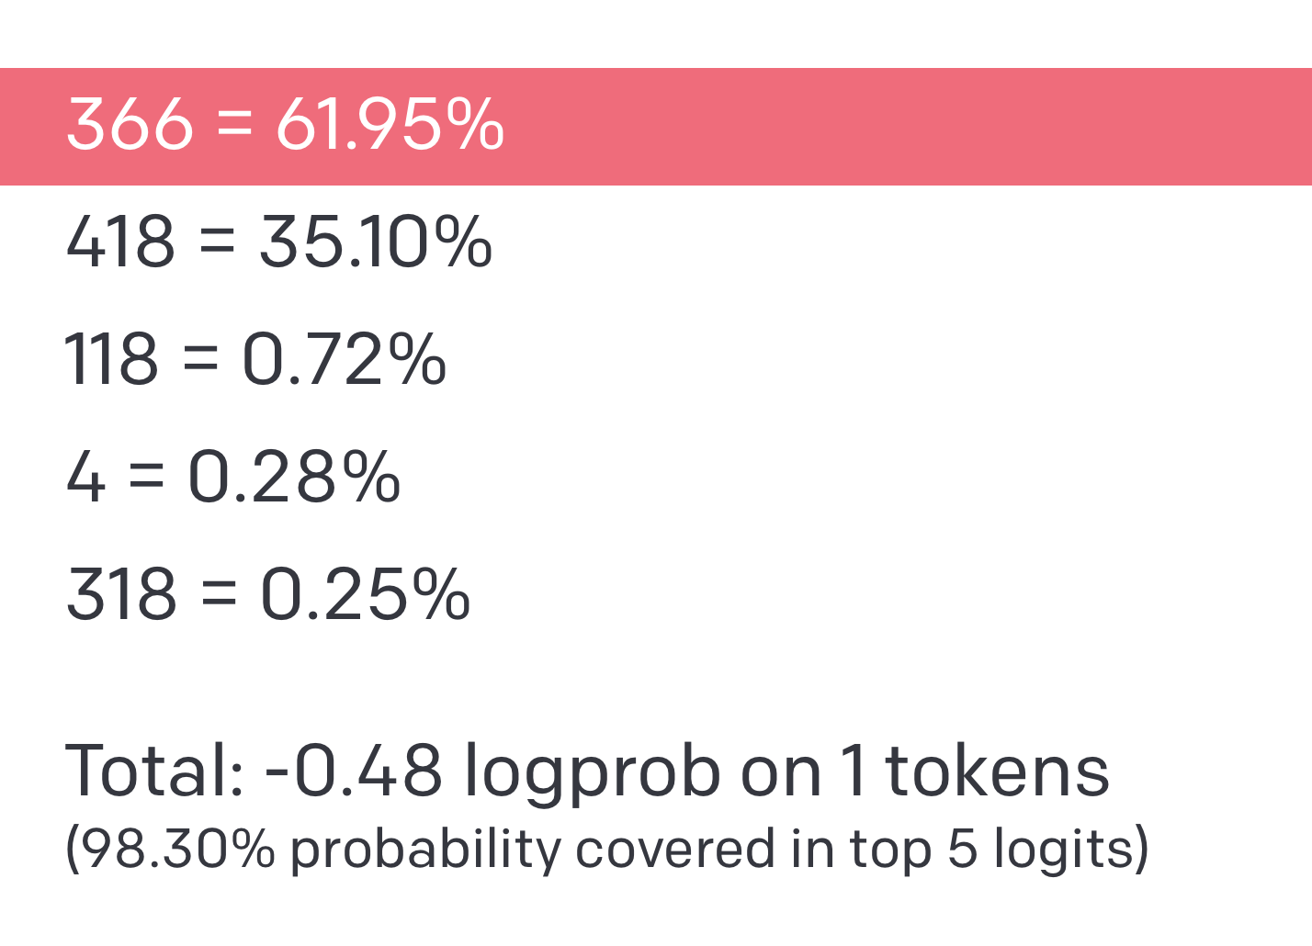
Notes:
https://www.polleverywhere.com/free_text_polls/1afdvEcNdmBOoC2pgl5Kk

Slide 16
Onderon
71
Polis Massa
Coruscant
87
151
Iridonia
75
Alderaan
140
Starkiller Base
92
Endor
99
118
Vandor-1
80
Ryloth
Tatooine
Lotho Minor
142
111
Naboo
211
97
70
98
Mandalore
85
Hoth
146
101
Bespin
75
138
86
Kessel
Dagobah
120
90
Fondor
Zygerria
Geonosis
Notes:
Alderaan Coruscant 75
Alderaan Starkiller Base 140
Alderaan Tatooine 118
Coruscant Onderon 71
Onderon Starkiller Base 151
Tatooine Lotho Minor 111
Lotho Minor Mandalore 70
Mandalore Dagobah 75
Dagobah Zygerria 120
Zygerria Ryloth 146
Zygerria Naboo 138
Ryloth Naboo 97
Ryloth Starkiller Base 80
Starkiller Base Endor 99
Kessel Naboo 101
Kessel Endor 211
Kessel Geonosis 90
Kessel Bespin 85
Bespin Hoth 98
Hoth Fondor 86
Vandor-1 Bespin 142
Iridonia Vandor-1 92
Polis Massa Iridonia 87
Alternate format
Alderaan | Coruscant | 75
Alderaan | Starkiller Base | 140
Alderaan | Tatooine | 118
Coruscant Onderon | 71
Onderon Starkiller Base | 151
Tatooine | Lotho Minor | 111
Lotho Minor | Mandalore | 70
Mandalore | Dagobah | 75
Dagobah | Zygerria | 120
Zygerria | Ryloth | 146
Zygerria | Naboo | 138
Ryloth | Naboo | 97
Ryloth | Starkiller Base | 80
Starkiller Base | Endor | 99
Kessel | Naboo | 101
Kessel | Endor | 211
Kessel | Geonosis | 90
Kessel | Bespin | 85
Bespin | Hoth | 98
Hoth | Fondor | 86
Vandor-1 | Bespin | 142
Iridonia | Vandor-1 | | 92
Polis Massa | Iridonia | 87

Slide 17
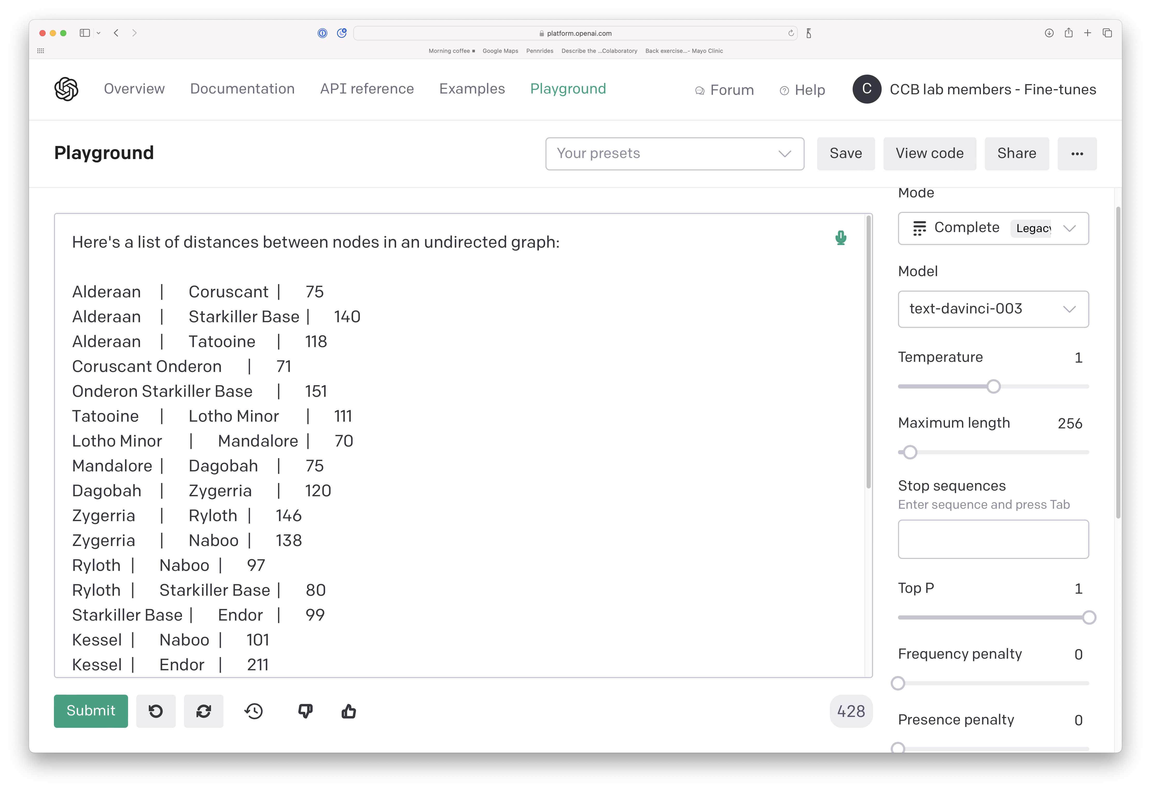
Notes:
Alderaan Coruscant 75
Alderaan Starkiller Base 140
Alderaan Tatooine 118
Coruscant Onderon 71
Onderon Starkiller Base 151
Tatooine Lotho Minor 111
Lotho Minor Mandalore 70
Mandalore Dagobah 75
Dagobah Zygerria 120
Zygerria Ryloth 146
Zygerria Naboo 138
Ryloth Naboo 97
Ryloth Starkiller Base 80
Starkiller Base Endor 99
Kessel Naboo 101
Kessel Endor 211
Kessel Geonosis 90
Kessel Bespin 85
Bespin Hoth 98
Hoth Fondor 86
Vandor-1 Bespin 142
Iridonia Vandor-1 92
Polis Massa Iridonia 87
Alternate format
Alderaan | Coruscant | 75
Alderaan | Starkiller Base | 140
Alderaan | Tatooine | 118
Coruscant Onderon | 71
Onderon Starkiller Base | 151
Tatooine | Lotho Minor | 111
Lotho Minor | Mandalore | 70
Mandalore | Dagobah | 75
Dagobah | Zygerria | 120
Zygerria | Ryloth | 146
Zygerria | Naboo | 138
Ryloth | Naboo | 97
Ryloth | Starkiller Base | 80
Starkiller Base | Endor | 99
Kessel | Naboo | 101
Kessel | Endor | 211
Kessel | Geonosis | 90
Kessel | Bespin | 85
Bespin | Hoth | 98
Hoth | Fondor | 86
Vandor-1 | Bespin | 142
Iridonia | Vandor-1 | | 92
Polis Massa | Iridonia | 87

Slide 18
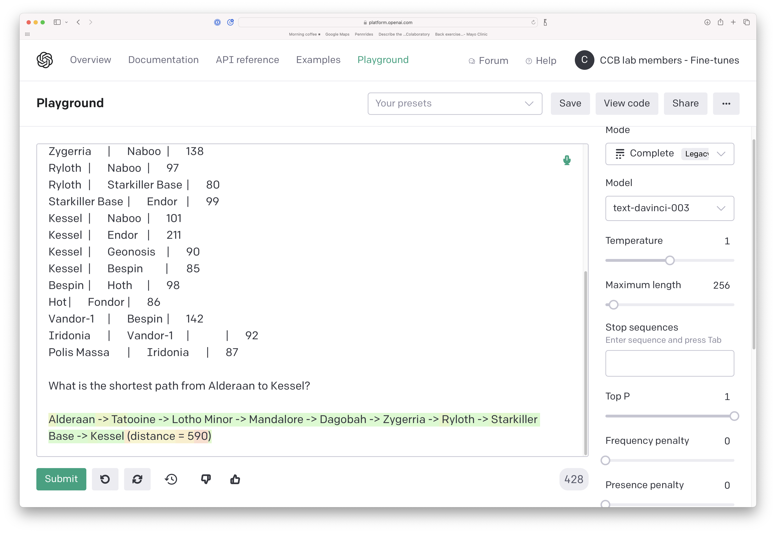
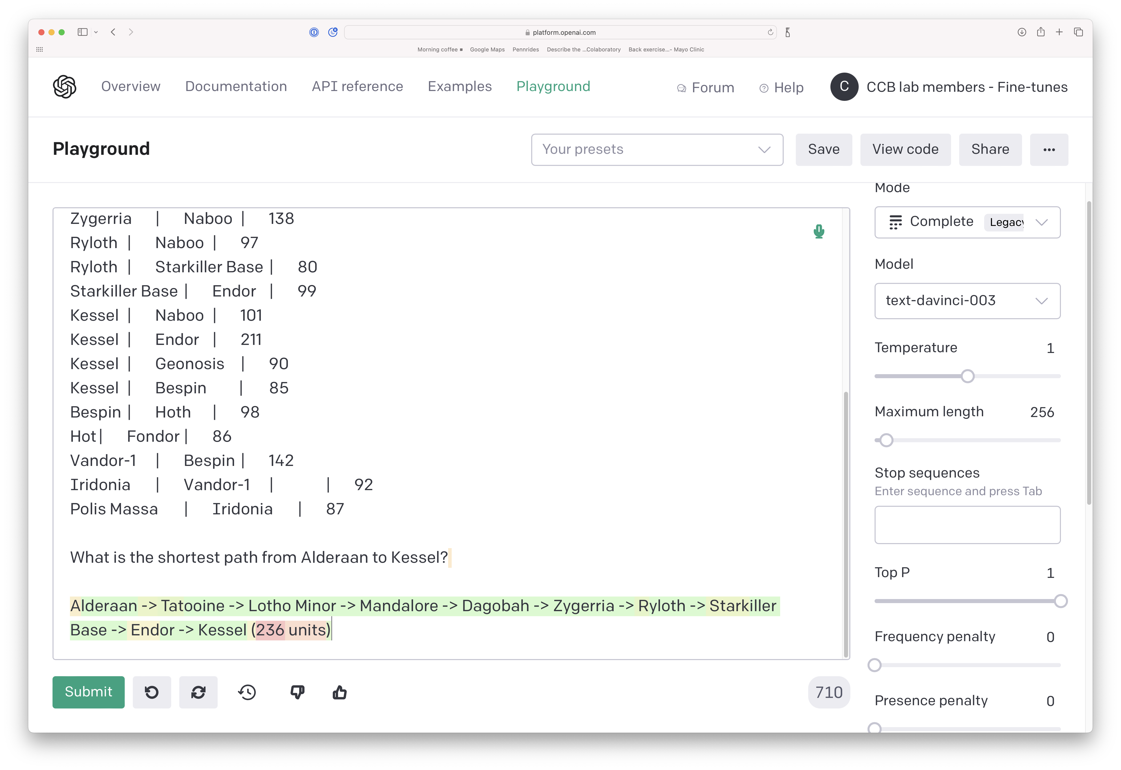
Notes:
Alderaan Coruscant 75
Alderaan Starkiller Base 140
Alderaan Tatooine 118
Coruscant Onderon 71
Onderon Starkiller Base 151
Tatooine Lotho Minor 111
Lotho Minor Mandalore 70
Mandalore Dagobah 75
Dagobah Zygerria 120
Zygerria Ryloth 146
Zygerria Naboo 138
Ryloth Naboo 97
Ryloth Starkiller Base 80
Starkiller Base Endor 99
Kessel Naboo 101
Kessel Endor 211
Kessel Geonosis 90
Kessel Bespin 85
Bespin Hoth 98
Hoth Fondor 86
Vandor-1 Bespin 142
Iridonia Vandor-1 92
Polis Massa Iridonia 87
Alternate format
Alderaan | Coruscant | 75
Alderaan | Starkiller Base | 140
Alderaan | Tatooine | 118
Coruscant Onderon | 71
Onderon Starkiller Base | 151
Tatooine | Lotho Minor | 111
Lotho Minor | Mandalore | 70
Mandalore | Dagobah | 75
Dagobah | Zygerria | 120
Zygerria | Ryloth | 146
Zygerria | Naboo | 138
Ryloth | Naboo | 97
Ryloth | Starkiller Base | 80
Starkiller Base | Endor | 99
Kessel | Naboo | 101
Kessel | Endor | 211
Kessel | Geonosis | 90
Kessel | Bespin | 85
Bespin | Hoth | 98
Hoth | Fondor | 86
Vandor-1 | Bespin | 142
Iridonia | Vandor-1 | | 92
Polis Massa | Iridonia | 87

Slide 19
Search Problems
HW1 is due tonight
Optional HW2 Recitation on Wednesday 8-9pm
Read the AIMA textbook Chapter 3 “Problem Solving by Search” (Sections 3.1-3.4). Quiz on Canvas due by Sunday.
Professor Chris Callison-Burch
Notes:
https://www.polleverywhere.com/activities
videos:
-
authors: SRI International
url: https://www.youtube.com/watch?v=7bsEN8mwUB8
title: Shakey the Robot&colon; The First Robot to Embody Artificial Intelligence
length: 6 minutes
This module will introduce a broad class of problems in artificial intelligence called search problems. We can formulate many problems in computer science as search problems, all of which can be solved using the same set of methods.
The problem-solving methods that we’ll look at in this module come from earlier work in algorithms, especially shortest path algorithms. We'll see how we can apply shortest path algorithms to many problems where we need to search through a space of possible sequences of actions in order to reach our desired goal.
In this module, you will learn how to formally define a search problem, and about a range of different algorithms for arriving at a solution for this general mathematical definition of search problems. The class of search algorithms that we’ll be look at in this module is called uninformed search algorithms. The “uninformed” part of the name comes from the fact that we don't have any additional information about the environment that we're exploring. In the next module, we’ll look at how we can use additional information to enhance the search algorithms.
We will look at classic algorithms like depth first search and breadth first search then we'll also look at some interesting variations on them that have some nice computational complexity features.

Slide 20
Defining Search Problems

Slide 21
Formal Definition
States: a set S
An initial state s_{i}∈ S
Actions: a set A
∀ s Actions(s) = the set of actions that can be executed in s, that are applicable in s.
Transition Model: ∀ s∀ a∈Actions(s) Result(s, a) → s_{r}
s_{r} is called a successor of s
{s_{i} }∪ Successors(s_{i} )* = state space
Path cost (Performance Measure): Must be additive, e.g. sum of distances, number of actions executed, …
c(x,a,y) is the step cost, assumed ≥ 0
(where action a goes from state x to state y)
Goal test: Goal(s)
Can be implicit, e.g. checkmate(s)
s is a goal state if Goal(s) is true
Notes:
To formally define a search problem, we need six things.
First, we need to have a set of States.
Second, we need to designate one of those States as the initial state.
Third, we need to define a set of possible actions that we can take from any state in our set of States. To determine the set of possible actions from a state, we introduce a function that takes in a state, and returns the set of actions that are legal in that state.
Fourth, we need a transition model which is a function that takes as input a state, and a possible action, and then returns the result of applying an action from that state. This result is another state. The transition model is literally a transition from one state to another.
The resulting state is sometimes called the successor of the input state. We can think of the space of possible states as recursively finding all successors of the initial state.
This transition model is going to come up in our subsequent problem definitions, where we ease the restriction that the task environment must be deterministic. Later in the course, we will talk about task environments that are stochastic. At that point, our transition model will shift to one where we have a probabilistic definition of this transition model.
The fifth thing that we need for our formal definition of search problems is a performance measure, which will tell us for a given path, how much it costs. This will allow us to determine whether one path from the initial state to the goal state is better than another path to the goal state.
Must be additive, e.g. sum of distances, number of actions executed, …
c(x,a,y) is the step cost, assumed ≥ 0
(where action a goes from state x to state y)
The final thing we need for our formal definition is a goal test. This can either be explicit, meaning I'm just going to check to see whether the state is in a subset that I designate as goal States. For the Romanian travel problem, our goal is a particular state it's Bucharest.
It can also be implicit. Our goal can be defined by a set of possible configurations on a chess board, for instance. If the particular state of the chess board is in the checkmate position, then this goal test would return true.
----
INITIAL STATE
2) The initial state that the agent starts in. For example, the initial state for our agent in Romania might be described as In(Arad).
ACTIONS
3) A description of the possible actions available to the agent. Given a particular state s, ACTIONS(s) returns the set of actions that can be executed in s. We say that each of APPLICABLE these actions is applicable in s. For example, from the state In(Arad), the applicable actions are {Go(Sibiu), Go(Timisoara), Go(Zerind)}.
TRANSITION MODEL
4) A description of what each action does; the formal name for this is the transition model, specified by a function RESULT(s, a) that returns the state that results from SUCCESSOR doing action a in state s. We also use the term successor to refer to any state reachable from a given state by a single action.2 For example, we have RESULT(In(Arad),Go(Zerind)) = In(Zerind).
1) STATE SPACE
Together, the initial state, actions, and transition model implicitly define the state space of the problem—the set of all states reachable from the initial state by any sequence GRAPH of actions. The state space forms a directed network or graph in which the nodes are states and the links between nodes are actions. (The map of Romania shown in Figure 3.2 can be interpreted as a state-space graph if we view each road as standing for two driving actions, one in each direction.)
5) PATH A path in the state space is a sequence of states connected by a sequence of actions.
PATH COST A path cost function that assigns a numeric cost to each path. The problem-solving agent chooses a cost function that reflects its own performance measure. For the agent trying to get to Bucharest, time is of the essence, so the cost of a path might be its length in kilometers. In this chapter, we assume that the cost of a path can be described as the sum of the costs of the individual actions along the path. STEP COST The step cost of taking action a in state s to reach state s is denoted by c(s, a, s). The step costs for Romania are shown in Figure 3.2 as route distances. We assume that step costs are nonnegative.
6) GOAL TEST • The goal test, which determines whether a given state is a goal state. Sometimes there is an explicit set of possible goal states, and the test simply checks whether the given state is one of them. The agent’s goal in Romania is the singleton set {In(Bucharest)}. Sometimes the goal is specified by an abstract property rather than an explicitly enumerated set of states. For example, in chess, the goal is to reach a state called “checkmate,” where the opponent’s king is under attack and can’t escape.

Slide 22
Vacuum World
States: A state of the world says which objects are in which cells.
In a simple two cell version,
the agent can be in one cell at a time
each cell can have dirt or not
2 positions for agent * 2² possibilities for dirt = 8 states.
With n cells, there are n*2^{n} states.
Notes:
Let's now look how our formal definition applies to another search problem that’s described in the textbook. This is a grid world, we have a world that consists of a grid of cells. In this grid world we have a tiny number of cells - just two. Each of the N cells can be dirty or clean. We’ll also have a robot, which can be in one of the cells at any given point in time.
The first thing that we need to formally define to convert this into a search problem is the set of states. Here the states will depend on the number of cells in the gridworld, whether each cell is currently clean or dirty, and the location of the vacuum agent.
For the vacuum cleaner gridworld, how many states are there? We've got two cells which means two possible positions for the agent then we've got for each cell, it can be in one of two conditions, either dirty or clean. The number of unique conditions for N cells is 2 to the power of N.
In this tiny vacuum world, we have 8 possible states. The diagram shows all eight of those possible states.
In general for this vacuum world if we have N cells that we have N times 2^ N possible states.
In our problem definition, when we formulate this as a search problem, we not only have to define what our set of states are, but we also have to designate one as the initial state.
We can pick arbitrarily among all these eight possible states and our algorithms should be able to find the goal state given any of these as starting states.
In addition to defining the set of possible States and designating a start state, we need to define the transition model. What is our set of actions and how do we move between these different eight possible States?

Slide 23
Vacuum World
States: A state of the world says which objects are in which cells.
In a simple two cell version,
the agent can be in one cell at a time
each cell can have dirt or not
2 positions for agent * 2² possibilities for dirt = 8 states.
With n cells, there are n*2^{n} states.
Notes:
Let's now look how our formal definition applies to another search problem that’s described in the textbook. This is a grid world, we have a world that consists of a grid of cells. In this grid world we have a tiny number of cells - just two. Each of the N cells can be dirty or clean. We’ll also have a robot, which can be in one of the cells at any given point in time.
The first thing that we need to formally define to convert this into a search problem is the set of states. Here the states will depend on the number of cells in the gridworld, whether each cell is currently clean or dirty, and the location of the vacuum agent.
For the vacuum cleaner gridworld, how many states are there? We've got two cells which means two possible positions for the agent then we've got for each cell, it can be in one of two conditions, either dirty or clean. The number of unique conditions for N cells is 2 to the power of N.
In this tiny vacuum world, we have 8 possible states. The diagram shows all eight of those possible states.
In general for this vacuum world if we have N cells that we have N times 2^ N possible states.
In our problem definition, when we formulate this as a search problem, we not only have to define what our set of states are, but we also have to designate one as the initial state.
We can pick arbitrarily among all these eight possible states and our algorithms should be able to find the goal state given any of these as starting states.
In addition to defining the set of possible States and designating a start state, we need to define the transition model. What is our set of actions and how do we move between these different eight possible States?

Slide 24
Vacuum World
Goal states: States where everything is clean.
Goal states: States where everything is clean.
States: A state of the world says which objects are in which cells.
In a simple two cell version,
the agent can be in one cell at a time
each cell can have dirt or not
2 positions for agent * 2² possibilities for dirt = 8 states.
With n cells, there are n*2^{n} states.
One state is designated as the initial state
Notes:
Let's now look how our formal definition applies to another search problem that’s described in the textbook. This is a grid world, we have a world that consists of a grid of cells. In this grid world we have a tiny number of cells - just two. Each of the N cells can be dirty or clean. We’ll also have a robot, which can be in one of the cells at any given point in time.
The first thing that we need to formally define to convert this into a search problem is the set of states. Here the states will depend on the number of cells in the gridworld, whether each cell is currently clean or dirty, and the location of the vacuum agent.
For the vacuum cleaner gridworld, how many states are there? We've got two cells which means two possible positions for the agent then we've got for each cell, it can be in one of two conditions, either dirty or clean. The number of unique conditions for N cells is 2 to the power of N.
In this tiny vacuum world, we have 8 possible states. The diagram shows all eight of those possible states.
In general for this vacuum world if we have N cells that we have N times 2^ N possible states.
In our problem definition, when we formulate this as a search problem, we not only have to define what our set of states are, but we also have to designate one as the initial state.
We can pick arbitrarily among all these eight possible states and our algorithms should be able to find the goal state given any of these as starting states.
In addition to defining the set of possible States and designating a start state, we need to define the transition model. What is our set of actions and how do we move between these different eight possible States?

Slide 25
Vacuum World
Move Right
Suck
Actions:
Suck
Move Left
Move Right
(Move Up)
(Move Down)
Transition:
Suck – removes dirt
Move – moves in that direction, unless agent hits a wall, in which case it stays put.
Notes:
In the vacuum world, we have an action to suck up the dirt in the current cell. We have actions where we can go left, right, up and down. In this particular world, we don't really go up or down because it's just two adjacent cells, but in a larger gridworld would also have actions to move up and move down.
From each state we need to define what transition will happen if we apply an action in that state.
We can represent the transitions from state to state as a directed graph. The states are nodes and the actions are directed arcs that transition from one state to another.
For instance … [describe go right, describe suck]

Slide 26
Vacuum World
Right
Left
Suck
Suck
Right
Right
Left
Left
Suck
Suck
Right
Left
Notes:
Here’s the graph for the complete set of states for the 2-cell vacuum world.
Depending on the start state, not all states will be reachable.

Slide 27
Vacuum World
Right
Left
Suck
Suck
Right
Right
Left
Left
Suck
Suck
Action cost:
Uniform (all actions are equal cost)
Right
Left
Notes:
[action cost]
The final thing we need to define is the action costs. In this case, we're just going to say every action has uniform cost, which means every action costs the same. With the action cost, we have a fully defined mathematical representation of this vacuum world.

Slide 28
Vacuum World
Right
Left
Suck
Suck
Right
Right
Left
Left
Suck
Suck
Path cost:
Sum of all action costs along a path
Right
Left

Slide 29
Vacuum World
Initial state
Right
Left
Suck
Suck
Right
Right
Left
Left
Suck
Suck
Solution:
A path from the initial state to a goal state
Right
Left
Goal states

Slide 30
Example: 8-puzzle
States? List of 9 locations- e.g., [7,2,4,5,-,6,8,3,1]
Initial state? [7,2,4,5,-,6,8,3,1]
Actions? {Left, Right, Up, Down}
Transition Model? ...
Goal test? Check if goal configuration is reached
Path cost? Number of actions to reach goal
Notes:
[slide transition][8 puzzle]
Let's return to our example of eight puzzle how can I represent the states in the eight puzzle?
The order of all of the numbers is important, how the board is arranged is important. What we really care about is the location of the squares on the board, and then being able to enumerate all possible locations. Basically we could represent this either as a 2d array or just as a simple one dimensional array where we read off the order in order.
[click]
The start state is represented by this single array 7 2 4 5 blank 6 8 3 1 , that's a fine representation of the state of the board.
[click]
Then the initial state is just going to be one of these lists.
[click]
The actions we can define as the set of possible moves from the center. We can move that blank space up. We can move it to the right. We can move it up or down in some particular places like in the corner or along the sides, we're not going to be able to do everything.
[click]
The transition model is going to be the thing that changes the representation after we have applied that action.
[click]
For the goal test, we can iterate through the current state and check whether it is in ascending order.
[click]
The path cost , every move is just going to be equally weighted. Each action costs one and the total path cost is going to be the number of actions that we took.

Slide 31
Example: 8-puzzle
States? List of 9 locations- e.g., [7,2,4,5,-,6,8,3,1]
Initial state? [7,2,4,5,-,6,8,3,1]
Actions? {Left, Right, Up, Down}
Transition Model? ...
Goal test? Check if goal configuration is reached
Path cost? Number of actions to reach goal
Notes:
[slide transition][8 puzzle]
Let's return to our example of eight puzzle how can I represent the states in the eight puzzle?
The order of all of the numbers is important, how the board is arranged is important. What we really care about is the location of the squares on the board, and then being able to enumerate all possible locations. Basically we could represent this either as a 2d array or just as a simple one dimensional array where we read off the order in order.
[click]
The start state is represented by this single array 7 2 4 5 blank 6 8 3 1 , that's a fine representation of the state of the board.
[click]
Then the initial state is just going to be one of these lists.
[click]
The actions we can define as the set of possible moves from the center. We can move that blank space up. We can move it to the right. We can move it up or down in some particular places like in the corner or along the sides, we're not going to be able to do everything.
[click]
The transition model is going to be the thing that changes the representation after we have applied that action.
[click]
For the goal test, we can iterate through the current state and check whether it is in ascending order.
[click]
The path cost , every move is just going to be equally weighted. Each action costs one and the total path cost is going to be the number of actions that we took.

Slide 32
Art: Formulating a Search Problem
Decide:
Which properties matter & how to represent
Initial State, Goal State, Possible Intermediate States
Which actions are possible & how to represent
Operator Set: Actions and Transition Model
Which action is next
Path Cost Function
Formulation greatly affects combinatorics of search space and therefore speed of search
Notes:
There is an art of casting a problem as a search problem. The question we need to consider is: how do I take this real world problem, and then represent it in a way that’s compatible with our formal definition of a search problem. There are many ways that I might defining a set of states, a transition function, and the possible actions, etc.
The way that I choose to represent the states and the actions is going to have a huge impact on the speed of our search algorithms. If I increase the size of my state space by including elements of the real world that aren’t important to the search formulation, or if I include more actions than are necessary, then I may dramatically slow down the search because of the combinatorics of combing those things during the search process.

Slide 33
Hard subtask: Selecting a state space
Real world is absurdly complex
State space must be abstracted for problem solving
(abstract) State = set (equivalence class) of real-world states
(abstract) Action = equivalence class of combinations of real-world actions
e.g. Arad → Zerind represents a complex set of possible routes, detours, rest stops, etc
The abstraction is valid if the path between two states is reflected in the real world
Each abstract action should be “easier” than the real problem
Notes:
When we're formulating something as a search problem we’re engaging in process of creating a representation of the problem you. An important aspect of representing something as a search problem is abstracting away from anything that's not important to how we find a solution.
There's lots of things in the world that are important in our everyday actions, but which are not important for us to formulate a problem as a search problem.
For instance, if we're trying to travel along a map and find the quickest route from one city to another, the way that we can get there is relevant in real life. We take a taxi. We take an Uber, we drive ourself, we ride our bike, we walk, etc. But when we abstract the problem onto a search problem, that all those things essentially get collapsed into an equivalence class the action is just go from one location to a connected location.
The equivalence class combines those different ways of getting from Arad to an adjacent city onto a single action. This notion of abstraction Is great because it simplifies the real problem and reduces the number of actions that our search algorithms will have to apply when transitioning from one state to another

Slide 34
Useful Concepts
State space: the set of all states reachable from the initial state by any sequence of actions
When several operators can apply to each state, this gets large very quickly
Might be a proper subset of the set of configurations
Path: a sequence of actions leading from one state s_{j} to another state s_{k}
Solution: a path from the initial state s_{i} to a state s_{f} that satisfies the goal test
Search tree: a way of representing the paths that a search algorithm has explored. The root is the initial state, leaves of the tree are successor states.
Frontier: those states that are available for expanding (for applying legal actions to)
Notes:
As we start to formulate algorithms for solving search problems there are a number of concepts that will be useful. We’ve seen a couple of these concepts already.
One is the state space. That is the space of possible states that are reachable from the initial state by taking any possible sequence of actions. When we have a large number of actions that are possible from every state, then the state space is going to get large very early in the search.
Sometimes not all possible states are reachable from an initial state. In the 8-puzzle, you can’t get to every possible permutation of numbers from a given start state.
We’ve already seen the notion of a path, which is a sequence of actions that leads us from one state to another.
A solution is a path from the initial state to a state that satisfies our goal test.
Search algorithms, will start with initial state , expand it to get its successor states, and then expand those successors.
We’ll see that the process of searching can be represented as a search tree, where the root is the initial state, its branches are the actions to expand to a successor state, and the leaves are succsor states several layers down that haven’t been expanded yet. The tree’s branching factor will be determined by how many actions we can take at each state.
Along with the search tree is a concept that we call the frontier, which is going to be all the States that we have available to expand, meaning the successor states which we can pick from to apply an action to, in order to take the next step towards the solution.

Slide 35
Solutions and Optimal Solutions
A solution is a sequence of actions from the initial state to a goal state.
Optimal Solution: A solution is optimal if no solution has a lower path cost.
Notes:
A solution is simply a sequence of actions that takes us from the initial state to the goal state. There are many possible ways of moving from the initial state to a goal state. Some of them have a lower path costs than others.
Given our path cost definition, we are really interested in which solution is better than all of the others. This is called the optimal solution.
A solution is optimal if there is no other solutions that have a lower path cost than this solution. That's going to be a key to evaluate the goodness of the algorithms we've designed are guaranteed to result in an optimal solution.

Slide 36
Search Problems
HW2 is due Wednesday, Quiz is Due Sunday
HW2 Recitation was Wednesday 8-9pm. Recording is available
My OHs will be in-person on Mondays from 2-4pm in Towne M70 (mezzanine level near the fishbowl computing lab)
Professor Chris Callison-Burch
Notes:
https://www.polleverywhere.com/activities
videos:
-
authors: SRI International
url: https://www.youtube.com/watch?v=7bsEN8mwUB8
title: Shakey the Robot&colon; The First Robot to Embody Artificial Intelligence
length: 6 minutes
This module will introduce a broad class of problems in artificial intelligence called search problems. We can formulate many problems in computer science as search problems, all of which can be solved using the same set of methods.
The problem-solving methods that we’ll look at in this module come from earlier work in algorithms, especially shortest path algorithms. We'll see how we can apply shortest path algorithms to many problems where we need to search through a space of possible sequences of actions in order to reach our desired goal.
In this module, you will learn how to formally define a search problem, and about a range of different algorithms for arriving at a solution for this general mathematical definition of search problems. The class of search algorithms that we’ll be look at in this module is called uninformed search algorithms. The “uninformed” part of the name comes from the fact that we don't have any additional information about the environment that we're exploring. In the next module, we’ll look at how we can use additional information to enhance the search algorithms.
We will look at classic algorithms like depth first search and breadth first search then we'll also look at some interesting variations on them that have some nice computational complexity features.

Slide 37
Recap: Defining Search Problems

Slide 38
Formal Definition
States: a set S
An initial state s_{i}∈ S
Actions: a set A
∀ s Actions(s) = the set of actions that can be executed in s, that are applicable in s.
Transition Model: ∀ s∀ a∈Actions(s) Result(s, a) → s_{r}
s_{r} is called a successor of s
{s_{i} }∪ Successors(s_{i} )* = state space
Path cost (Performance Measure): Must be additive, e.g. sum of distances, number of actions executed, …
c(x,a,y) is the step cost, assumed ≥ 0
(where action a goes from state x to state y)
Goal test: Goal(s)
Can be implicit, e.g. checkmate(s)
s is a goal state if Goal(s) is true
Notes:
To formally define a search problem, we need six things.
First, we need to have a set of States.
Second, we need to designate one of those States as the initial state.
Third, we need to define a set of possible actions that we can take from any state in our set of States. To determine the set of possible actions from a state, we introduce a function that takes in a state, and returns the set of actions that are legal in that state.
Fourth, we need a transition model which is a function that takes as input a state, and a possible action, and then returns the result of applying an action from that state. This result is another state. The transition model is literally a transition from one state to another.
The resulting state is sometimes called the successor of the input state. We can think of the space of possible states as recursively finding all successors of the initial state.
This transition model is going to come up in our subsequent problem definitions, where we ease the restriction that the task environment must be deterministic. Later in the course, we will talk about task environments that are stochastic. At that point, our transition model will shift to one where we have a probabilistic definition of this transition model.
The fifth thing that we need for our formal definition of search problems is a performance measure, which will tell us for a given path, how much it costs. This will allow us to determine whether one path from the initial state to the goal state is better than another path to the goal state.
Must be additive, e.g. sum of distances, number of actions executed, …
c(x,a,y) is the step cost, assumed ≥ 0
(where action a goes from state x to state y)
The final thing we need for our formal definition is a goal test. This can either be explicit, meaning I'm just going to check to see whether the state is in a subset that I designate as goal States. For the Romanian travel problem, our goal is a particular state it's Bucharest.
It can also be implicit. Our goal can be defined by a set of possible configurations on a chess board, for instance. If the particular state of the chess board is in the checkmate position, then this goal test would return true.
----
INITIAL STATE
2) The initial state that the agent starts in. For example, the initial state for our agent in Romania might be described as In(Arad).
ACTIONS
3) A description of the possible actions available to the agent. Given a particular state s, ACTIONS(s) returns the set of actions that can be executed in s. We say that each of APPLICABLE these actions is applicable in s. For example, from the state In(Arad), the applicable actions are {Go(Sibiu), Go(Timisoara), Go(Zerind)}.
TRANSITION MODEL
4) A description of what each action does; the formal name for this is the transition model, specified by a function RESULT(s, a) that returns the state that results from SUCCESSOR doing action a in state s. We also use the term successor to refer to any state reachable from a given state by a single action.2 For example, we have RESULT(In(Arad),Go(Zerind)) = In(Zerind).
1) STATE SPACE
Together, the initial state, actions, and transition model implicitly define the state space of the problem—the set of all states reachable from the initial state by any sequence GRAPH of actions. The state space forms a directed network or graph in which the nodes are states and the links between nodes are actions. (The map of Romania shown in Figure 3.2 can be interpreted as a state-space graph if we view each road as standing for two driving actions, one in each direction.)
5) PATH A path in the state space is a sequence of states connected by a sequence of actions.
PATH COST A path cost function that assigns a numeric cost to each path. The problem-solving agent chooses a cost function that reflects its own performance measure. For the agent trying to get to Bucharest, time is of the essence, so the cost of a path might be its length in kilometers. In this chapter, we assume that the cost of a path can be described as the sum of the costs of the individual actions along the path. STEP COST The step cost of taking action a in state s to reach state s is denoted by c(s, a, s). The step costs for Romania are shown in Figure 3.2 as route distances. We assume that step costs are nonnegative.
6) GOAL TEST • The goal test, which determines whether a given state is a goal state. Sometimes there is an explicit set of possible goal states, and the test simply checks whether the given state is one of them. The agent’s goal in Romania is the singleton set {In(Bucharest)}. Sometimes the goal is specified by an abstract property rather than an explicitly enumerated set of states. For example, in chess, the goal is to reach a state called “checkmate,” where the opponent’s king is under attack and can’t escape.

Slide 39
Vacuum World
States: A state of the world says which objects are in which cells.
In a simple two cell version,
the agent can be in one cell at a time
each cell can have dirt or not
2 positions for agent * 2² possibilities for dirt = 8 states.
With n cells, there are n*2^{n} states.
Notes:
Let's now look how our formal definition applies to another search problem that’s described in the textbook. This is a grid world, we have a world that consists of a grid of cells. In this grid world we have a tiny number of cells - just two. Each of the N cells can be dirty or clean. We’ll also have a robot, which can be in one of the cells at any given point in time.
The first thing that we need to formally define to convert this into a search problem is the set of states. Here the states will depend on the number of cells in the gridworld, whether each cell is currently clean or dirty, and the location of the vacuum agent.
For the vacuum cleaner gridworld, how many states are there? We've got two cells which means two possible positions for the agent then we've got for each cell, it can be in one of two conditions, either dirty or clean. The number of unique conditions for N cells is 2 to the power of N.
In this tiny vacuum world, we have 8 possible states. The diagram shows all eight of those possible states.
In general for this vacuum world if we have N cells that we have N times 2^ N possible states.
In our problem definition, when we formulate this as a search problem, we not only have to define what our set of states are, but we also have to designate one as the initial state.
We can pick arbitrarily among all these eight possible states and our algorithms should be able to find the goal state given any of these as starting states.
In addition to defining the set of possible States and designating a start state, we need to define the transition model. What is our set of actions and how do we move between these different eight possible States?

Slide 40
Vacuum World
States: A state of the world says which objects are in which cells.
In a simple two cell version,
the agent can be in one cell at a time
each cell can have dirt or not
2 positions for agent * 2² possibilities for dirt = 8 states.
With n cells, there are n*2^{n} states.
Notes:
Let's now look how our formal definition applies to another search problem that’s described in the textbook. This is a grid world, we have a world that consists of a grid of cells. In this grid world we have a tiny number of cells - just two. Each of the N cells can be dirty or clean. We’ll also have a robot, which can be in one of the cells at any given point in time.
The first thing that we need to formally define to convert this into a search problem is the set of states. Here the states will depend on the number of cells in the gridworld, whether each cell is currently clean or dirty, and the location of the vacuum agent.
For the vacuum cleaner gridworld, how many states are there? We've got two cells which means two possible positions for the agent then we've got for each cell, it can be in one of two conditions, either dirty or clean. The number of unique conditions for N cells is 2 to the power of N.
In this tiny vacuum world, we have 8 possible states. The diagram shows all eight of those possible states.
In general for this vacuum world if we have N cells that we have N times 2^ N possible states.
In our problem definition, when we formulate this as a search problem, we not only have to define what our set of states are, but we also have to designate one as the initial state.
We can pick arbitrarily among all these eight possible states and our algorithms should be able to find the goal state given any of these as starting states.
In addition to defining the set of possible States and designating a start state, we need to define the transition model. What is our set of actions and how do we move between these different eight possible States?

Slide 41
Vacuum World
Goal states: States where everything is clean.
Goal states: States where everything is clean.
States: A state of the world says which objects are in which cells.
In a simple two cell version,
the agent can be in one cell at a time
each cell can have dirt or not
2 positions for agent * 2² possibilities for dirt = 8 states.
With n cells, there are n*2^{n} states.
One state is designated as the initial state
Notes:
Let's now look how our formal definition applies to another search problem that’s described in the textbook. This is a grid world, we have a world that consists of a grid of cells. In this grid world we have a tiny number of cells - just two. Each of the N cells can be dirty or clean. We’ll also have a robot, which can be in one of the cells at any given point in time.
The first thing that we need to formally define to convert this into a search problem is the set of states. Here the states will depend on the number of cells in the gridworld, whether each cell is currently clean or dirty, and the location of the vacuum agent.
For the vacuum cleaner gridworld, how many states are there? We've got two cells which means two possible positions for the agent then we've got for each cell, it can be in one of two conditions, either dirty or clean. The number of unique conditions for N cells is 2 to the power of N.
In this tiny vacuum world, we have 8 possible states. The diagram shows all eight of those possible states.
In general for this vacuum world if we have N cells that we have N times 2^ N possible states.
In our problem definition, when we formulate this as a search problem, we not only have to define what our set of states are, but we also have to designate one as the initial state.
We can pick arbitrarily among all these eight possible states and our algorithms should be able to find the goal state given any of these as starting states.
In addition to defining the set of possible States and designating a start state, we need to define the transition model. What is our set of actions and how do we move between these different eight possible States?

Slide 42
Vacuum World
Move Right
Suck
Actions:
Suck
Move Left
Move Right
(Move Up)
(Move Down)
Transition:
Suck – removes dirt
Move – moves in that direction, unless agent hits a wall, in which case it stays put.
Notes:
In the vacuum world, we have an action to suck up the dirt in the current cell. We have actions where we can go left, right, up and down. In this particular world, we don't really go up or down because it's just two adjacent cells, but in a larger gridworld would also have actions to move up and move down.
From each state we need to define what transition will happen if we apply an action in that state.
We can represent the transitions from state to state as a directed graph. The states are nodes and the actions are directed arcs that transition from one state to another.
For instance … [describe go right, describe suck]

Slide 43
Vacuum World
Right
Left
Suck
Suck
Right
Right
Left
Left
Suck
Suck
Right
Left
Notes:
Here’s the graph for the complete set of states for the 2-cell vacuum world.
Depending on the start state, not all states will be reachable.

Slide 44
Vacuum World
Right
Left
Suck
Suck
Right
Right
Left
Left
Suck
Suck
Action cost:
Uniform (all actions are equal cost)
Right
Left
Notes:
[action cost]
The final thing we need to define is the action costs. In this case, we're just going to say every action has uniform cost, which means every action costs the same. With the action cost, we have a fully defined mathematical representation of this vacuum world.

Slide 45
Vacuum World
Right
Left
Suck
Suck
Right
Right
Left
Left
Suck
Suck
Path cost:
Sum of all action costs along a path
Right
Left

Slide 46
Vacuum World
Initial state
Right
Left
Suck
Suck
Right
Right
Left
Left
Suck
Suck
Solution:
A path from the initial state to a goal state
Right
Left
Goal states

Slide 47
Useful Concepts
State space: the set of all states reachable from the initial state by any sequence of actions
When several operators can apply to each state, this gets large very quickly
Might be a proper subset of the set of configurations
Path: a sequence of actions leading from one state s_{j} to another state s_{k}
Solution: a path from the initial state s_{i} to a state s_{f} that satisfies the goal test
Optimal Solution: A solution is optimal if no solution has a lower path cost.
Search tree: a way of representing the paths that a search algorithm has explored. The root is the initial state, leaves of the tree are successor states.
Frontier: those states that are available for expanding (for applying legal actions to)
Notes:
As we start to formulate algorithms for solving search problems there are a number of concepts that will be useful. We’ve seen a couple of these concepts already.
One is the state space. That is the space of possible states that are reachable from the initial state by taking any possible sequence of actions. When we have a large number of actions that are possible from every state, then the state space is going to get large very early in the search.
Sometimes not all possible states are reachable from an initial state. In the 8-puzzle, you can’t get to every possible permutation of numbers from a given start state.
We’ve already seen the notion of a path, which is a sequence of actions that leads us from one state to another.
A solution is a path from the initial state to a state that satisfies our goal test.
Search algorithms, will start with initial state , expand it to get its successor states, and then expand those successors.
We’ll see that the process of searching can be represented as a search tree, where the root is the initial state, its branches are the actions to expand to a successor state, and the leaves are succsor states several layers down that haven’t been expanded yet. The tree’s branching factor will be determined by how many actions we can take at each state.
Along with the search tree is a concept that we call the frontier, which is going to be all the States that we have available to expand, meaning the successor states which we can pick from to apply an action to, in order to take the next step towards the solution.

Slide 48
Basic Search Algorithms
Notes:
Let's take a look at a basic search algorithm and see how using it will lead to a tree based representation of the search space.

Slide 49
Basic search algorithms: Tree Search
Generalized algorithm to solve search problems
Enumerate in some order all possible paths from the initial state
Here: search through explicit tree generation
ROOT= initial state.
Nodes in search tree generated through transition model
Tree search treats different paths to the same node as distinct
Notes:
We're going to talk about the tree search algorithm, which is a generalized algorithm for solving a search problem. The way that the algorithm performs search is to build a tree based data structure that represents the space of States that we have searched.
Each node in the tree contains a state. The edges between two nodes represent an action that is taken by applying our transition function to the state in the parent node. And returning the state and the child node.
The root of the tree is the initial state. The tree is built by first applying all the actions that are available on the initial state. Each action represents a branch.
Leaf nodes can be expanded in the same way that the root node was expanded. We will expand these nodes in a particular order. The order that we expand the nodes in will determine the type of search that we're doing.
We'll see in a moment, another kind of basic search algorithm called the graph search. The key difference between tree search and graph search is that tree search treats different paths to the same node as distinct.

Slide 50
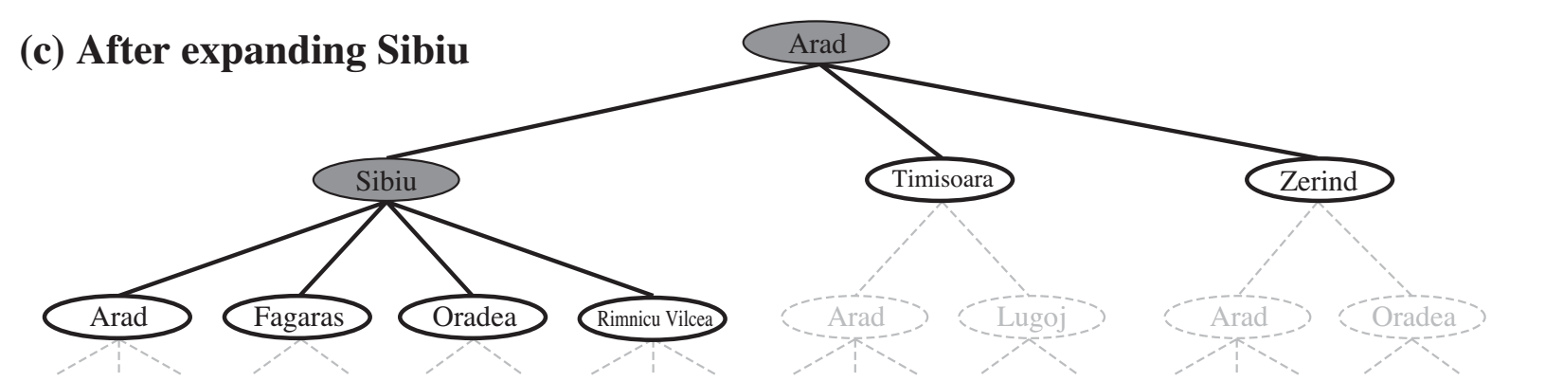
Generalized tree search
The strategy determines search process!
function TREE-SEARCH(problem, strategy) return a solution or failure
Initialize frontier to the initial state of the problem
do
if the frontier is empty then return failure
choose leaf node for expansion according to strategy & remove from frontier
if node contains goal state then return solution
else expand the node and add resulting nodes to the frontier
Notes:
`is the code for the tree search algorithm. The tree search algorithm will take as input a search problem, including the initial state, the transition function and all those other details.
It will return a solution to the search problem. It'll also take in something called a strategy, which is going to determine the order in which we expand the nodes.
The first step of the tree search function is to initialize the frontier. The frontier keeps track of all the states that are available to be expanded. We'll see that a priority queue is a good data structure to use for the frontier.
Initially, we put the problem's start state onto the frontier. In the pseudo code we then enter a do loop that keeps running until the frontier is empty, or until we reach a goal state.
If the frontier is empty, then there is no solution to our search problem, so we return a variable that denotes failure to find a solution. In Python we might use the None variable to represent failure.
If there are still nodes in the frontier, then we can continue searching for a solution. We select a node from the frontier and check to see whether it is one of our goal states.
If so, we've found a solution to the search problem. The solution can be computed by walking up the tree, starting at the current node, containing the goal state and going back up layer by layer until we reached the root node.
As we're doing this, we can record each action that was taken along the path. That'll form the solution.
If the node that is removed from the frontier is not a goal state, it can be expanded. All of the nodes on the frontier are leaf nodes on the search tree. They are called leaf nodes because they have not yet been expanded and therefore do not have any nodes beneath them.
When we remove a node from the frontier, we expand it by applying the transition function to all of the actions that are available for its state. That creates children nodes that are then added to the frontier.
the strategy that we use to pick which elements of the frontier to expand will result in different kinds of search. For instance, a different strategy could result in a depth versus search or a breadth first search.

Slide 51
States Versus Nodes
A state is a (representation of a) physical configuration
A node is a data structure constituting part of a search tree
Also includes parent, children, depth, path cost g(x)
Here node = <state, parent-node, children, action, path-cost, depth>
States do not have parents, children, depth or path cost!
The EXPAND function
uses the Actions and Transition Model to create the corresponding states
creates new nodes,
fills in the various fields
Node
State
parent
Action= Up
Cost = 6
Depth = 6
7 | 2 | 4
5 | 6 | 1
8 | 3
state
children
Notes:
When we are implementing tree search, then it's useful to think about the difference between the states, which are elements of our search problem and the nodes in our search trees, which are a data structure that includes the state plus some additional information. For the eight puzzle, the state is a physical configuration of the board. A node in the search tree contains that state as part of its data structure, but it has other things like a pointer to the parent node, the current node's children and optionally, some other variables that we want to keep track of, like how deep in the search tree we are, or what's the path cost to traverse from the start state to this state.
The pseudo code for the tree search function describes an expand function that's applied to the node that is removed from the frontier. The expand function uses the actions that are possible from the state contained in the node being expanded. It applies the transition function to create the successor states. It then returns a new set of nodes filling in the various other fields that are needed for the node data structure, like the nodes depth in the tree or its path cost.
For each node n of the tree, we have a structure that contains four components:
• n.STATE: the state in the state space to which the node corresponds;
• n.PARENT: the node in the search tree that generated this node;
• n.ACTION: the action that was applied to the parent to generate the node;
• n.PATH-COST: the cost, traditionally denoted by g(n), of the path from the initial state to the node, as indicated by the parent pointers.
* n.CHILDREN (optional) often used as a function.

Slide 52
8-Puzzle Search Tree
(Nodes show state, parent, children - leaving Action, Cost, Depth Implicit)
7 | 2 | 4
5 |  | 6
8 | 3 | 1
7 | 2 | 4
 | 5 | 6
8 | 3 | 1
7 |  | 4
5 | 2 | 6
8 | 3 | 1
7 | 2 | 4
5 | 6
8 | 3 | 1
(Suppressing useless “backwards” moves)
 | 2 | 4
7 | 5 | 6
8 | 3 | 1
7 | 2 | 4
8 | 5 | 6
 | 3 | 1
 | 7 | 4
5 | 2 | 6
8 | 3 | 1
7 | 4
5 | 2 | 6
8 | 3 | 1
7 | 2
5 | 6 | 4
8 | 3 | 1
7 | 2 | 4
5 | 6 | 1
8 | 3
Notes:
Here's an example of a search tree for the eight puzzle. The root node of this search tree is an initial state of the puzzle. The four nodes immediately underneath the root node contain a state that is reachable from the start state by applying one action.
Remember that nodes are data structures that contain a variety of information like pointers to the parent and children, the action that was taken, the depth and the tree, the path cost, and so on. I'm not explicitly representing that information in this figure, but it would be contained in a node's data structure.
One of the things that I'm suppressing in this figure is backwards moves. I'm not showing this in the search diagram, but for instance, if I took the left child here from the root node then it could have a third child, which was just moving back to the start state.
However, going back to a previous state is going to be useless since it will increase the cost of the solution. Redundant loops, meaning going through the same state repeatedly, are therefore bad. In general for search problems the notion of repeatedly visiting the same state is going to be a problem that search algorithms should address.

Slide 53
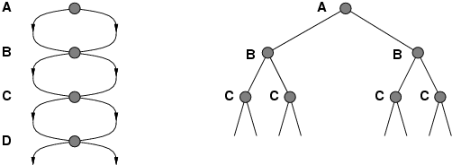
Problem: Repeated states
Failure to detect repeated states can turn a linear problem into an exponential one!
A
A
B
B
B
C
C
C
C
C
D
Notes:
here's an example of why repeatedly visiting states is such a serious problem for search algorithms. If an algorithm fails to detect repeated states, then a linear problem can become an exponential one. This figure shows an example of a linear problem on the left and then an exponential version of it on the right.
Imagine that from state A, we get either walk or bike to state B once we're in B, we can either walk or bike to state C. The search tree on the right has these actions generate separate nodes for the redundant actions, and the search space grows exponentially. If we aren't careful, then we'll turn a tractable problem into an intractable one. To avoid this we want to make sure that we avoid redundantly expanding the same state that we've expanded before.

Slide 54
Solution: Graph Search!
S
B
S
B
C
C
C
S
B
S
State Space
Search Tree
Graph search
Simple Mod from tree search: Check to see if a node has been visited before adding to search queue
must keep track of all possible states (can use a lot of memory)
e.g., 8-puzzle problem, we have 9!/2 ≈182K states
Notes:
the solution to this is graph search. Graph search is a fairly simple modification of tree search. It adds just one little thing. It adds a check to see if the state in a node that we're expanding has been visited before. If the state has been visited before, then we won't add this node or its successors to the frontier.
In order to keep track of which states we've already visited, we'll have to have an auxiliary data structure. One downside of this auxiliary data structure is that it has to record every state that we visited as a result, it can be quite large, even for the simple eight puzzle game we have on the order of nine factorial possible states. We have 182,000 possible states for the eight puzzle.
If we have to record every single one of them as being visited then the amount of memory that we use for this auxiliary data structure can get large.

Slide 55
Graph Search vs Tree Search
function TREE-SEARCH(problem) returns a solution, or failure
initialize the frontier using the initial state of problem
loop do
if the frontier is empty then return failure
choose a leaf nose and remove it from the frontier
if the node contains a goal state then return the corresponding solution
expand the chosen node, adding the resulting nodes to the frontier
function GRAPH-SEARCH(problem) returns a solution, or failure
initialize the frontier using the initial state of problem
initialize the explored set to be empty
loop do
if the frontier is empty then return failure
choose a leaf node and remove it from the frontier
if the node contains a goal state then return the corresponding solution
add node to the explored set
expand the chosen node, adding the resulting nodes to the frontier
only if not in the frontier of explored set
Notes:
Here's a side-by-side comparison of the pseudo code for tree search versus the pseudo code for graph search. The graph search function introduces a new auxiliary data structure called the explored set. The explored set is initially set to be empty .
Within the loop every time we remove a leaf from the frontier, we add its state to the explored set to ensure that we don't repeatedly visit that state. Whenever we expand the chosen node we first check to see whether the new nodes are in the explored set before we add them to the frontier. We don't add the new nodes to the frontier if they've already been explored. This ensures that we do not repeatedly visit the same state.

Slide 56

Uninformed Search Strategies
AIMA 3.3-3.4
Notes:
In the pseudo code for tree search, we said that we would choose what node from the frontier to expand according to some strategy.
There are several different search strategies called uninformed search strategies that prioritize which nodes to expand based on when we added them to the frontier queue. We’ll analyze the behavior of two well-known uninformed search strategies called breadth first search and depth first search (BSF and DFS for short), and some variants on them.

Slide 57
Uninformed search strategies:
AKA “Blind search”
Uses only information available in problem definition
Informally:
Uninformed search: All non-goal nodes in frontier look equally good
Informed search: Some non-goal nodes can be ranked above others.
57
Notes:
Uninformed search is also called “blind search” because algorithms like BFS or DFS only use information available from the problem definition. They do not use any information about the instance of a search problem. For example, they don’t use any information about the 8-puzzle like how far away a tile is from where it should be.
Informally, that means all of the non goal nodes on the frontier look equally good. We could pick any of them.
In the next module, we will start looking at informed search where we will differentiate between the node and non-goal nodes and allow some of them to take priority.
They will be pushed up ahead in the queue and we will take heuristic information about the world into account when we prioritize some over others.

Slide 58
Search Strategies
Review: Strategy = order of tree expansion
Implemented by different queue structures (LIFO, FIFO, priority)
Dimensions for evaluation
Completeness- always find the solution?
Optimality - finds a least cost solution (lowest path cost) first?
Time complexity - # of nodes generated (worst case)
Space complexity - # of nodes simultaneously in memory (worst case)
Time/space complexity variables
b, maximum branching factor of search tree
d, depth of the shallowest goal node
m, maximum length of any path in the state space (potentially ∞)
Notes:
Ask students: What does LIFO stand for? What does FIFO stand for?
Which is a Stack? (LIFO)
What do we mean by a search strategy? A search strategy provides the order in which we expand the nodes that are in the frontier queue.
The way that we handle the ordering of the frontier queue when we implement a search algorithm is via a queue.
There are several different kinds of queue. Each of them have a different ordering in how items are dequeued. The 3 kinds of queues are:
a LIFO queue has a “Last In First Out” order. Meaning the item that was most recently added to the queue will be the thing that we dequeue next.
a FIFO queue has a “Last In First Out” order. This means that the item that was least recently added to the queue will be the first thing that we dequeue.
A priority queue will allow us to assign a value to each item as we enqueue it. This will allow us to control the order in which things get dequeued in interesting ways.
By implementing that frontier as these different kinds of queues, we will change the order that it expands nodes on the frontier. We can change our search strategy from a depth-first search strategy to a breadth-first search strategy, simply by replacing a LIFO queue with a FIFO.
Depending on which strategy we give it, the search will have different behaviors. There are several ways that we will evaluate the behaviors of a search strategy.
The first is completeness. Is this search strategy always guaranteed to find a solution if one exists? If so, it is complete. If not, it is not complete.
The next is optimality - does it always return the lowest cost solution first? An optimal search
is guaranteed to return a solution that has the lowest path cost, compared to any other possible.
We will also evaluate the complexity of search strategies both in terms of their running time and in terms of the amount of memory that they will use (their space complexity).
When we are doing our complexity analysis of search strategies, there are several variables that we’ll use repeatedly. Here are the variables and their definitions:
b is the branching factor. This is going to be the maximum set of possible actions that I can take from any state to get to any other state.
d will represent the depth of a goal node in my search tree. If there are multiple goal nodes then d corresponds to the shallowest depth of any of the goal nodes.
the variable m will represent the maximum length of any path in the search space. If the graph is cyclic then some search strategies can get stuck in infinite loops. Sometimes the search spaces themselves are infinite which also means m could be infinite.

Slide 59
Introduction to space complexity
You know about:
“Big O” notation
Time complexity
Space complexity is analogous to time complexity
Units of space are arbitrary
Doesn’t matter because Big O notation ignores constant multiplicative factors
Plausible Space units:
One Memory word
Size of any fixed size data structure
For example, size of fixed size node in search tree
Notes:
You have studied complexity analysis and “Big Oh” notation in your previous courses on data structures and algorithms. Usually complexity analysis focuses on the running time of algorithms. We’ll look at both the asymptotic running time behavior of different search strategies, and also the asymptotic space requirements. You can think of the space complexity as the amount of memory that a search strategy will require to store the auxiliary data structures, like the visited set. We can reuse Big Oh notation for worst-case space requirements.
Units of space are arbitrary. It doesn't actually matter if we talk about kilobytes or megabytes or bytes or whatever.
The reason that the units don’t matter is that big O ignores constants. It ignores the thousands or millions when we're talking about the number of bytes used in memory. Big O notation still allows us to compare the upper bounds of space usage required by different search algorithms.

Slide 60
Breadth-First Search and Depth-First Search
Notes:
In your algorithms class you will have encountered breadth first search and depth first search before. Let’s review these uninformed search strategies and evaluate their properties. Are they complete and optimal? What is their worst case complexity?

Slide 61
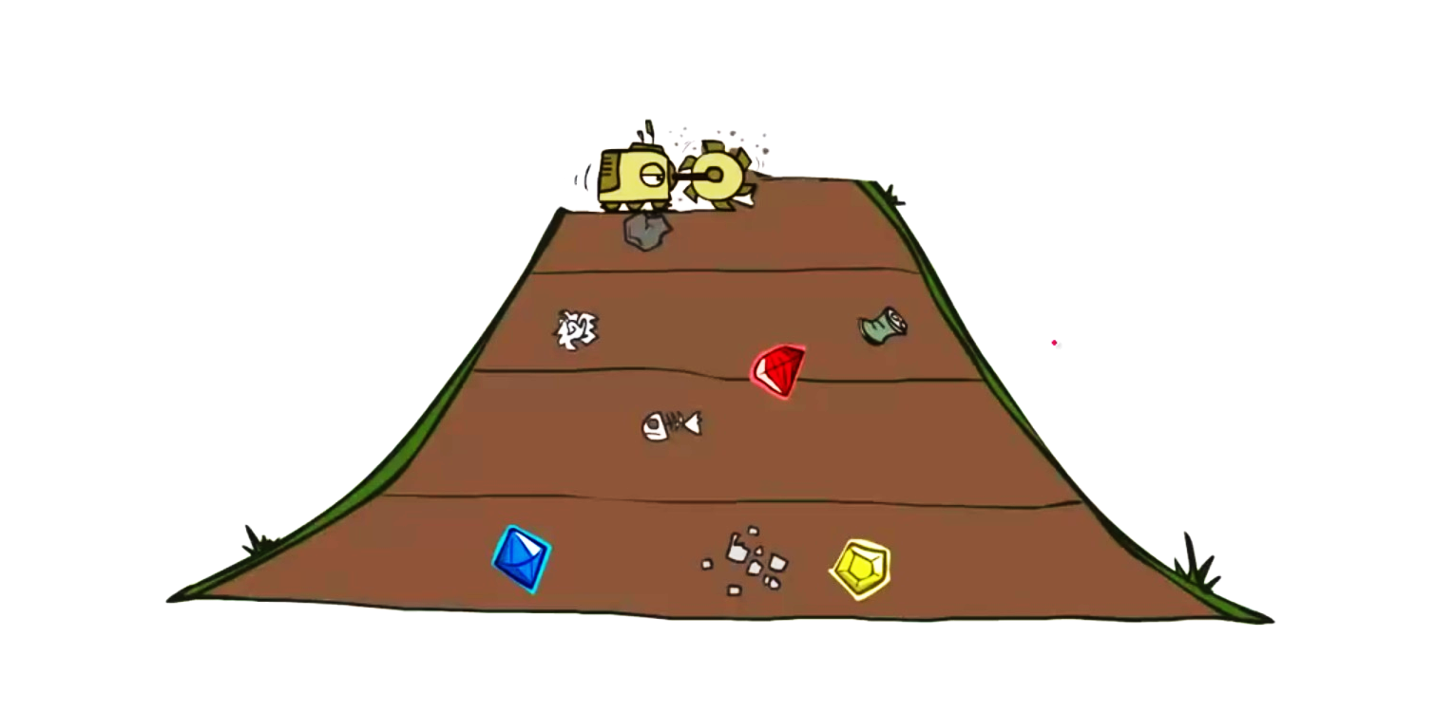
Breadth-first search
Idea:
Expand shallowest unexpanded node
Implementation:
frontier is FIFO (First-In-First-Out) Queue:
Put successors at the end of frontier successor list.
Image credit: Dan Klein and Pieter Abbeel
http://ai.berkeley.edu
Notes:
Let’s start with BFS. The idea is to expand the shallowest unexpanded node.
BSF starts at the goal state, gradually radiating outwards, expanding the nodes based on how close they are to the start state.
In order to implement breadth-first search, we use a FIFO queue for the frontier queue.
Every time we create a successor node in the search tree, that node is appended to the end of the list. Every time we dequene the next node to expand, we get it from the front of the list. The behavior of the FIFO queue results in a breadth first search.

Slide 62
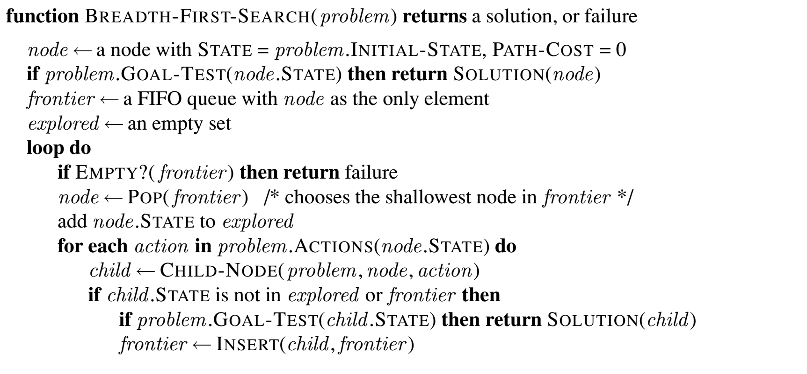
Breadth-first search (simplified)
Position within queue of new items determines search strategy
Subtle: Node inserted into queue only after testing to see if it is a goal state
Notes:
Subtlty: If the algorithm were to apply the goal test to nodes when selected for expansion, rather than when generated, the whole layer of nodes at depth d would be expanded before the goal was detected and the time complexity would be O(b^{d+1}).

Slide 63
Breadth-first search
Position within queue of new items determines search strategy
Notes:
Here is the pseudocode for BFS.
Remember that we made a distinction between nodes and states. States are part of our search problem, and nodes are the data structures that we use in our search algorithms. The node data structure contains additional info,.
To initialize our BFS, we create anode from the state that we designate as the initial state in our search problem.
We do a quick goal check for this initial state. If it is, then we’re done, and we just return this node. If not, then we create two data structures that we’ll use in BFS:
the frontier, which we’ll implement as a FIFO queue for BSF
A set called reached that records the states that we’ve already reached. This set will prevent us from repeatedly expanding the same states.
We add the initial state to the reached set and its corresponding node to the frontier queue.
The algorithm then loops, and checks if the frontier is empty. If our frontier is ever empty, then that means there is no solution. There's no way of reaching a goal state from this start state. The algorithm returns a special variable to indicate failure. In Python, we might return the None variable.
If the frontier is not empty, then we will pop something off the queue.
[Click to expand word balloon.]
Because we've implemented the queue as a FIFO queue, the pop operation will return the shallowest node –aka the unexpanded node that is closest to the initial node.
We will apply the expand function to that node.

Slide 64
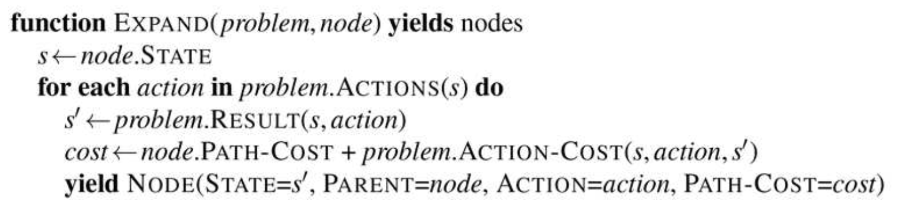
Breadth-first search
Node data structure contains variables like the state, a pointer to its parent node, the action that was used to create this state, and the path cost.
The Python yield keyword means that we don’t have to pre-compute a list of all successors.
Notes:
Here’s the pseudocode for the expand function.
The expand function applies each action that is possible from the current state, and generates its successor states (which we call its children). The search problem definition defines the state that will result from applying an action to a state.
The problem definition also defines the action cost. In BFS on unweighted graphs the action cost is simply 1.
We then create a new node data structure for each of the state’s successor states. The node data structure contains variables like the state, a pointer to the parent node, the action that was used to get to this state, and the total path cost so far.
The yield keyword in the pseudocode is used similarly to how it is used in Python. We do not have to precompute the full list of successors. Instead we can return them one at a time, like with Python generators.

Slide 65
Breadth-first search
Subtle: Node inserted into queue only after testing to see if it is a goal state
Notes:
For each of the successor states, we check to see if it is a goal state. If so, we have found a solution, and we return that node as the solution. Note that the full path from the goal state to the start state can be found using the variables on the child node data structure.
If the child node doesn’t pass the goal test, then we check to see if we’ve already reached this state. If not, we add it to the frontier queue and mark that we have now reached it.
[click]
When the node is inserted into the queue is when we check to see whether it's goal state.
If we don't do this, then we can run the algorithm for one step too long, and the complexity will be increased by the number of nodes at that layer.

Slide 66
Properties of breadth-first search
Complete? Yes (if b is finite)
Optimal? Yes, if cost = 1 per step (not optimal in general)
Time Complexity? 1+b+b²+b³+… +b^{d} = O(b^{d})
Space Complexity? O(b^{d}) (keeps every node in memory)
b: maximum branching factor of search tree
d: depth of the least cost solution
m: maximum depth of the state space (∞)
Notes:
Draw search tree on board.
An exponential complexity bound such as O(b^d) is SCARY!
Would this be optimal for the Romanian Map example? No.
Would this be optimal for the 8-puzzle
Let’s take a moment to analyze the properties of breadth first search.
Is BFS complete, is it guaranteed to find a solution? And the answer is yes if the branching factor is finite.
Is BFS optimal? Guaranteed to return the shortest path as the solution?
The answer is yes, under the condition that every action has an equivalent cost.
If every action costs one like in the 8-puzzle, then BFS is guaranteed to find the solution that's shallowest in the tree.
However, if our costs from traveling one to another node is variable, like in a map task where the cost is the number of miles traveled or the time to get between two cities, then BFS isn't optimal and it's not guaranteed to find the shortest path first.
We’ll see related search algorithms that let us find the shortest paths through weighted graphs instead of unweighted graphs.
We can analyze the runtime complexity of it. First, insert the first node as the initial state. Then go through each of the possible children of the initial state. Then go through each of the possible children of the first layer of children and each of the possible children of the next layer.
That's going to be 1 + b + b ^2 + b ^ 3 + ..., because we're just branching our factor depending on our layers up to the maximum depth of the shallowest goal node.
The asymptotic complexity is to only pay attention to that last factor b to the power of d.
Because we're recording every node that we visited in our our data structure, so that we don't look through the same thing again. The space complexity is going to be the same as O(b^d).
Note that this running time is fine for small problems where the depth of the least cost solution is small. However, the exponential means that for larger values of d, BFS will take a long time to compute a solution and a lot of memory. In general, exponential complexity search problems cannot be solved by uninformed search for anything but the smallest problems.

Slide 67
Exponential Space (and time) Is Not Good...
Exponential complexity uninformed search problems cannot be solved for any but the smallest instances.
(Memory requirements are a bigger problem than execution time.)
Assumes b=10, 1M nodes/sec, 1000 bytes/node
DEPTH | NODES | TIME | MEMORY
2 | 110 | 0.11 milliseconds | 107 kilobytes
4 | 11110 | 11 milliseconds | 10.6 megabytes
6 | 10⁶ | 1.1 seconds | 1 gigabytes
8 | 10⁸ | 2 minutes | 103 gigabytes
10 | 10¹⁰ | 3 hours | 10 terabytes
12 | 10¹² | 13 days | 1 petabytes
14 | 10¹⁴ | 3.5 years | 99 petabytles
Notes:
Let’s really hammer home the importance of that exponential in the complexity.
The only way that we're able to explore any search problem is if there's going to be tiny instances.
This will especially come through not just in the time complexity, but also in the memory requirements.
Two lessons can be learned from Figure 3.13.
1) the memory requirements are a bigger problem for breadth-first search than is the execution time. One might wait 13 days for the solution to an important problem with search depth 12, but no personal computer has the petabyte of memory it would take. Fortunately, other strategies require less memory.
2) time is still a major factor. If your problem has a solution at depth 16, then (given our assumptions) it will take about 350 years for breadth-first search (or indeed any uninformed search) to find it. In general, exponential-complexity search problems cannot be solved by uninformed methods for any but the smallest instances.

Slide 68

Depth-first search
Idea:
Expand deepest unexpanded node
Implementation:
frontier is LIFO (Last-In-First-Out) Queue:
Put successors at the front of frontier successor list.
Image credit: Dan Klein and Pieter Abbeel
http://ai.berkeley.edu

Slide 69
Properties of depth-first search
Complete? No. It fails in infinite-depth spaces, spaces with loops
If we modify it to avoid repeated states along path, then it is complete in finite spaces
Optimal? No
Time? O(b^{m}). This is terrible if m is much larger than d
but if solutions are dense, may be much faster than breadth-first
Space? O(b*m), i.e., linear space!
b: maximum branching factor of search tree
d: depth of the least cost solution
m: maximum depth of the state space (∞)

Slide 70
Depth-first vs Breadth-first
Use depth-first if
Space is restricted
There are many possible solutions with long paths and wrong paths are usually terminated quickly
Search can be fine-tuned quickly
Use breadth-first if
Possible infinite paths
Some solutions have short paths
Can quickly discard unlikely paths

Slide 71
Search Conundrum
Breadth-first
🗹 Complete,
🗹 Optimal 🗷 but uses O(b^{d}) space
Depth-first
🗷 Not complete unless m is bounded
🗷 Not optimal
🗷 Uses O(b^{m}) time; terrible if m >> d
🗹 but only uses O(b*m) space
How can we get the best of both?
Notes:
1. Breadth-first only for small spaces.
2. Depth-first only for known solution depth and admissibility not important.

Slide 72
Depth-limited search: A building block
Depth-First search but with depth limit l.
i.e. nodes at depth l have no successors.
No infinite-path problem!
If l = d (by luck!), then optimal
But:
If l < d then incomplete ☹
If l > d then not optimal ☹
Time complexity:
Space complexity: ☺
O(b¹)
O(bl)

Slide 73
Iterative deepening search
A general strategy to find best depth limit l.
Key idea: use Depth-limited search as subroutine, with increasing l.
For l = 0 to ∞ do
depth-limited-search to level l
if it succeeds
then return solution
Complete & optimal: Goal is always found at depth d, the depth of the shallowest goal-node.
Could this possibly be efficient?

Slide 74
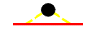
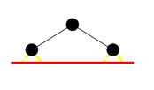
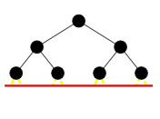
Nodes constructed at each deepening
Depth 0: 0 (Given the node, doesn’t construct it.)
Depth 1: b¹ nodes
Depth 2: b nodes + b² nodes
Depth 3: b nodes + b² nodes + b³ nodes
…

Slide 75
Total nodes constructed:
Depth 0: 0 (Given the node, doesn’t construct it.)
Depth 1: b¹ = b nodes
Depth 2: b nodes + b² nodes
Depth 3: b nodes + b² nodes + b³ nodes
…
Suppose the first solution is the last node at depth 3:
Total nodes constructed:
3*b nodes + 2*b² nodes + 1*b³ nodes

Slide 76
ID search, Evaluation: Time Complexity
More generally, the time complexity is
(d)b + (d-1)b² + … + (1)b^{d} = O(b^{d})
As efficient in terms of O(…) as Breadth First Search:
b + b² + … + b^{d} = O(b^{d})
76

Slide 77
ID search, Evaluation
Complete: YES (no infinite paths) ☺
Time complexity:
Space complexity: ☺
Optimal: YES if step cost is 1. ☺
O(b^{d})
O(bd)

Slide 78
Summary of algorithms
Criterion | Breadth-First | Depth-First | Depth-limited | Iterative deepening
Complete? | YES | NO | NO | YES
Time | b^{d} | b^{m} | b^{l} | b^{d}
Space | b^{d} | bm | bl | bd
Optimal? | YES | NO | NO | YES

Slide 79
Next Up: Informed Search
AIMA 3.5-3.6

Slide 80
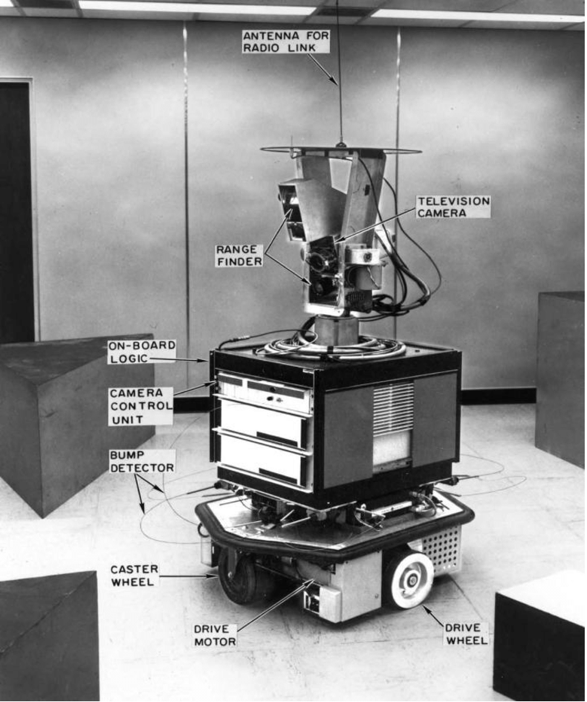
Informed Search
An informed search strategy uses domain-specific information about the location of the goals in order to find a solution more efficiently than uninformed search.
Hints will come as part of a heuristic function denoted h(n).
One of the most famous informed search algorithms is A* which was developed for robot navigation. Shakey the robot was developed at the Stanford Research Institute from 1966 to 1972.
https://www.youtube.com/watch?v=7bsEN8mwUB8

Slide 81

Copyright 2021 University of Pennsylvania No reproduction or distribution without permission.

